Slide 1

Password Security Policy
Creating Strong, Safe Passwords

Slide 2
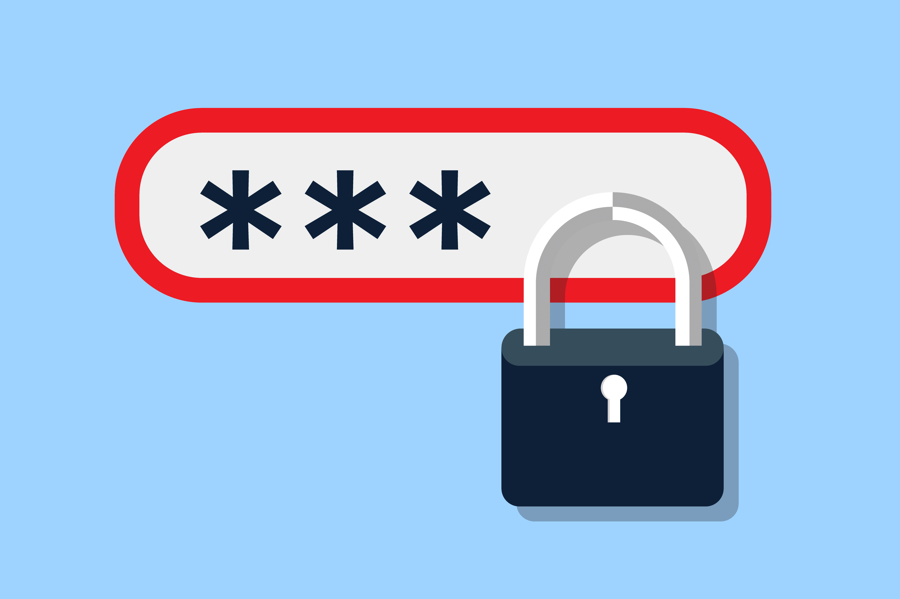
Introduction
• Passwords protect accounts, systems, and data
• Weak passwords are the most common security weakness
• Support staff must follow strong password standards

Slide 3

Why This Policy Matters
• A strong password prevents unauthorized access to systems and confidential data.
• Weak or reused passwords can be easily guessed or stolen, leading to
• - account compromise
• - data breaches
• - disciplinary action for staff responsible.

Slide 4
Password Requirements
• Minimum 14–16 characters
• Use passphrases made of multiple unrelated words
• Must not include personal details
• Must not follow predictable patterns
• Avoid common passwords like “Password123” or “Welcome123”

Slide 5
Passphrase Guidelines
• Combine several random words
• Easy to remember, hard to guess
• Examples:
- Egg–Forehead–Clap–Hungary
- Correct–Horse–Battery–Staple
• Longer = more secure

Slide 6
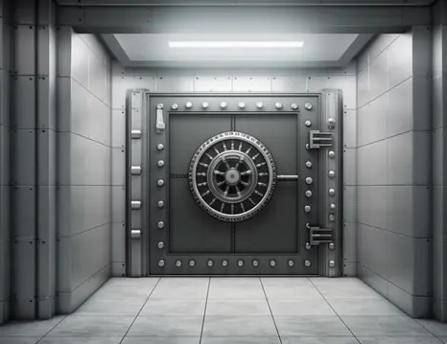
Password Handling Rules
• Never email or verbally share passwords
• Never store passwords in plain text
• Change immediately if compromised
• Always pair with Multi-Factor Authentication (MFA)

Slide 7

Compliance
• Compliance will be verified through audits and system monitoring
• Exceptions require prior Infosec approval
• Violations may result in disciplinary action

Slide 8
Thanks for Listening

